Slide 1
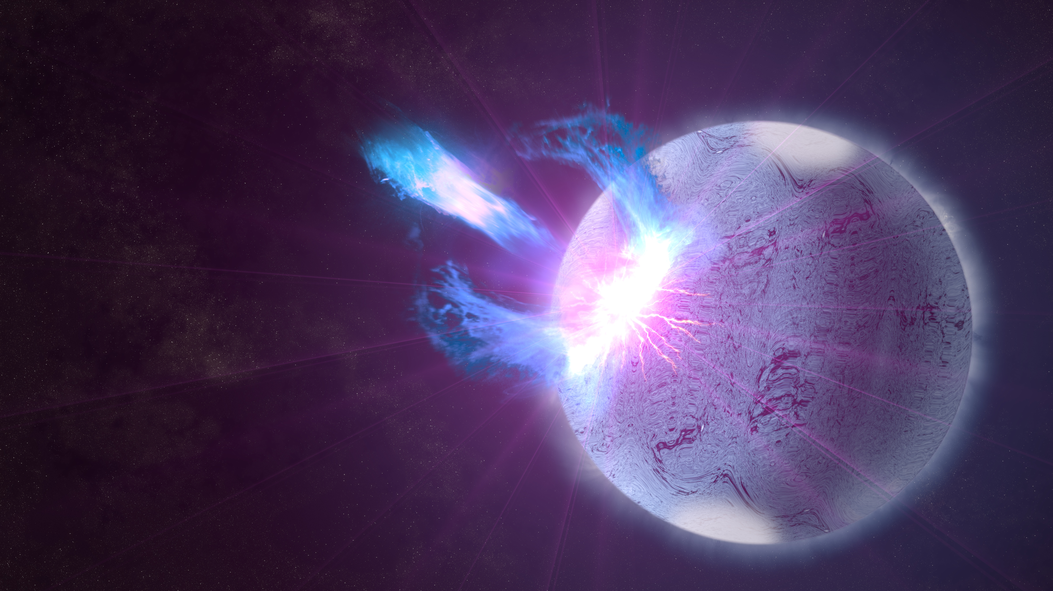
Gravitational Waves from Magnetar Giant Flares
Maxwell A. Fine
1004714400
PHYD01
Supervised by:
Dr. Sarah Gossan & Dr. Bryan Gaensler
Image Credit: NASA's Goddard Space Flight Center; S. Wiessinger

Slide 2
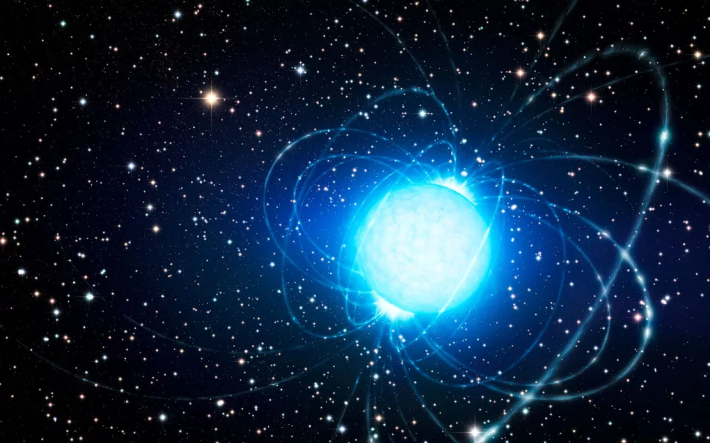
Magnetars
They are a type of neutron star, they form from the collapsed cores of dead supergiant stars after they have gone supernova
Radius ~ 13km
Mass ~ 1.4 M_{sun}
Density ~ 10¹⁷ kg/m³ , comparable to the density of atomic nuclei
B_{surf} ~ 10¹¹ T, that is 10⁷ stronger than the sun's magnetic field
Image Credit: ESO/L. Calçada
Sources: Mazets et al. (1979); Olausen & Kaspi (2014); Hurley et al. (1999); Palmer et al. (2005); Raaijmakers et al. (2020).

Slide 3
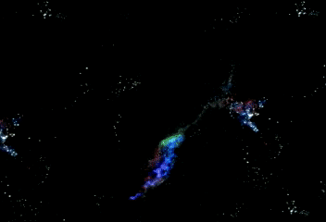
Magnetars Giant Flares
Giant Flares are highly energetic transient phenomena they emit ~ 10³⁸ Joules, the equivalent of the output of the sun for ~ 10⁴ years
Rare, there are only 3 confirmed magnetar giant flares
Duration of < 1 second
There are two proposed driving mechanisms, a magnetohydrodynamic model and a starquake model
Image Credit : NASA

Slide 4
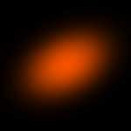
Observations of Magnetars Giant Flares
Observations of giant flares indicate that the magnetar is enveloped by a fireball during the flare
Conventional observations cannot probe what is happening inside the fireball
For conventional observations, the effects of the starquake and magnetohydrodynamic proposed driving mechanisms are indistinguishable – they cannot probe the dynamics of the flare
Model of the fading afterglow of giant flare from SGR 1806–20
Image Credit: NRAO / CfA / Bryan Gaensler

Slide 5
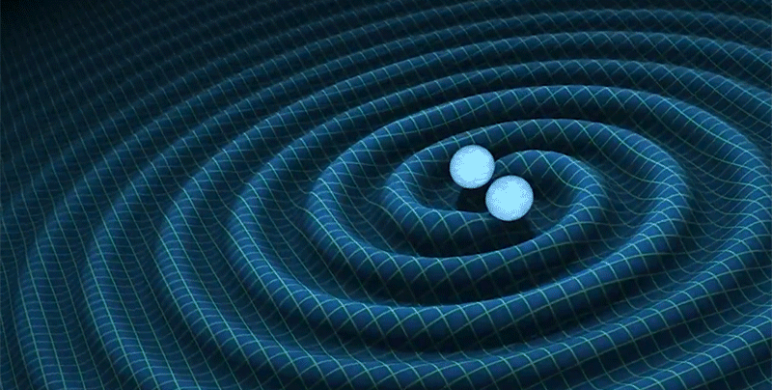
Gravitational Waves
Observations would allow the probing of the internal dynamics of magnetars at the time of a giant flare
They are emitted by accelerating masses, and deformed rotating objects
Gravitational waves are ripples in space-time
Image Credit: LIGO/T. Pyle

Slide 6
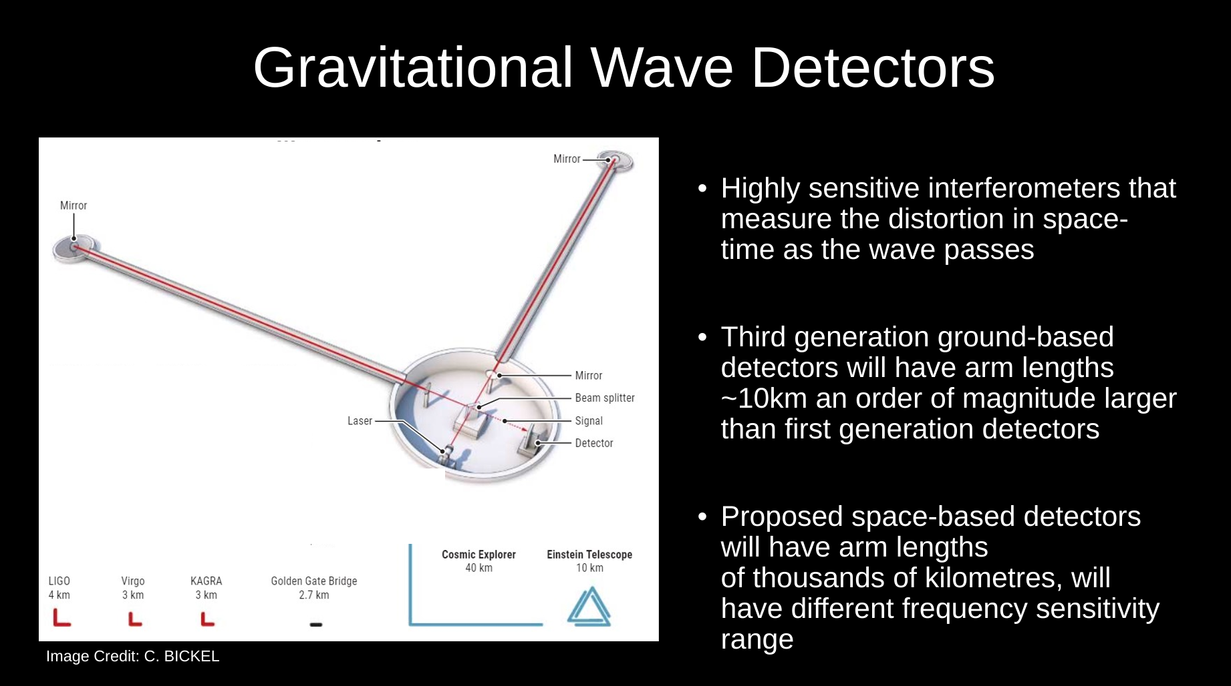
There are also proposals for space-based detectors, such as LISA. They will be sensitive for a different frequency regime compared to ground-based

Slide 7
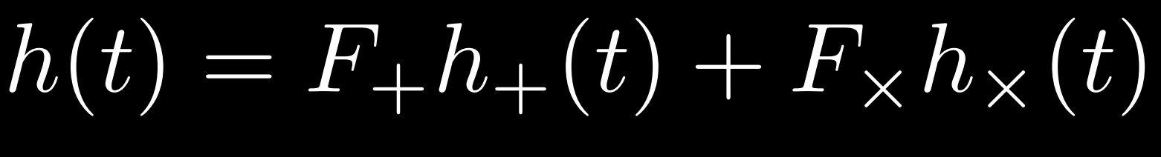
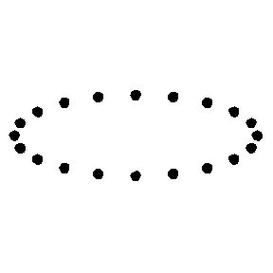
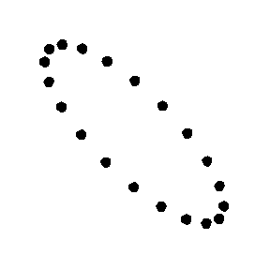
Gravitational Wave Strain: h(t)
What is measured by the detector
Gravitational wave strain h(t) is dimensionless
F₊ , F_{x} are the detector's antenna functions
h₊ , h_{x} are the gravitational wave polarizations
h₊
h_{x}
Image Credit: wikimedia/Tgr

Slide 8
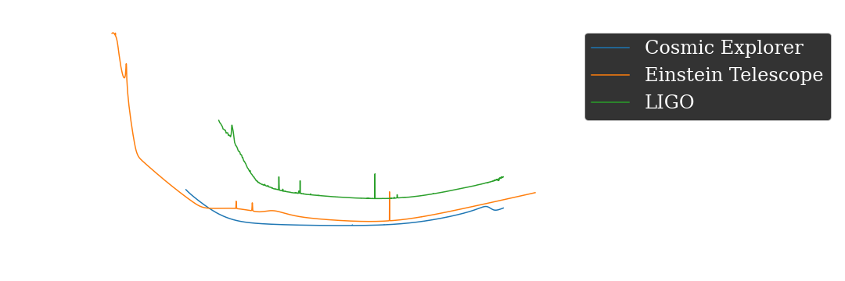
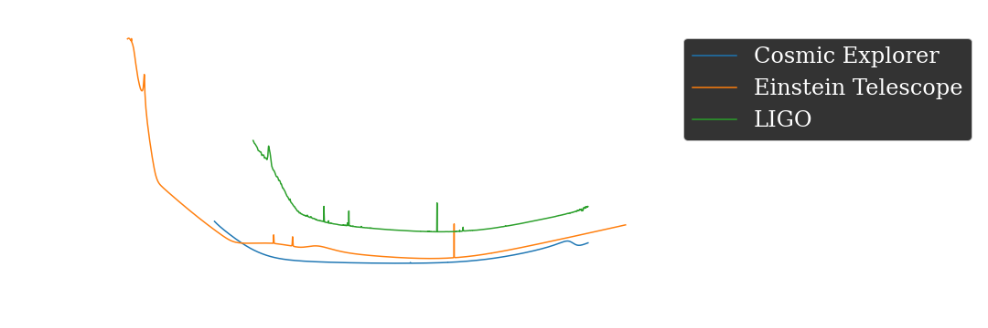
Sensitivity of Detectors
Sensitivity of detectors is characterised by their power spectral density denoted as S_{h}(f)
Third generation detectors like Cosmic Explorer and the Einstein Telescope will be orders of magnitude more sensitive than first generation detectors like LIGO
Ground-based detectors are sensitive for signals in the 10¹ − 10³ Hz regime, while proposed space-based detectors will be sensitive for signals in the 10⁻⁴ – 10⁻¹ Hz regime
Sources: Cosmic Explorer Collab, Einstein Telescope Collab

Slide 9
Project Objectives:
Improve our understanding of magnetar giant flares using gravitational waves
Determine if it is possible for the next generation of ground-based detectors, specifically Cosmic Explorer & the Einstein Telescope to observe gravitational wave emission from magnetar giant flares

Slide 10
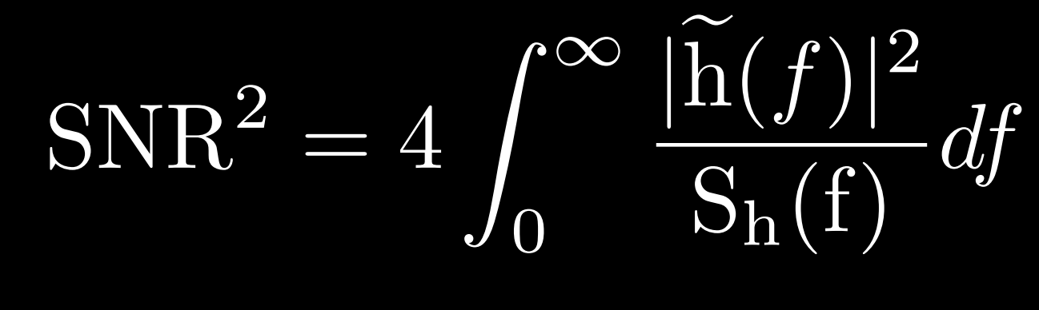
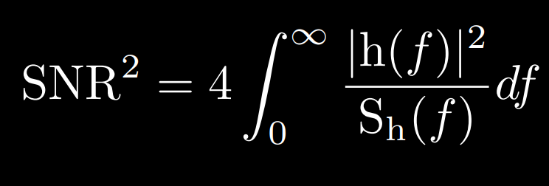
Methods: Signal-To-Noise (SNR) Estimation
If the SNR is 8 or above, then a detector should be able to observe giant flares. This is a commonly used detection threshold in gravitational wave astronomy
The SNR depends on the observing detector
The calculation requires the Fourier transform of the strain: h(t) ⇨ h(f), and the power spectra density of the detector: S_{h}(f)
Source Sathyaprakash & Schutz, (2009)

Slide 11
Methods: Signal-To-Noise (SNR) Estimation
If the SNR is 8 or above, then a detector should be able to observe giant flares. This is a commonly used detection threshold in gravitational wave astronomy
The SNR depends on the observing detector
The calculation requires the Fourier transform of the strain: h(t) ⇨ h(f), and the power spectra density of the detector: S_{h}(f)
Fourier transform of strain
Power spectral density of the detector
Source Sathyaprakash & Schutz, (2009)

Slide 12
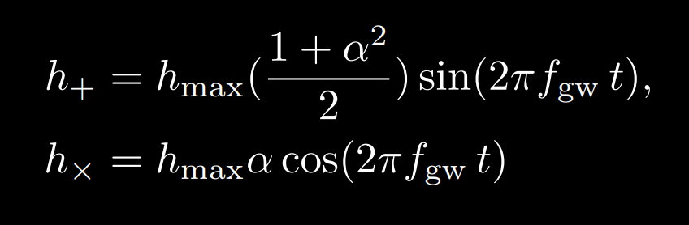
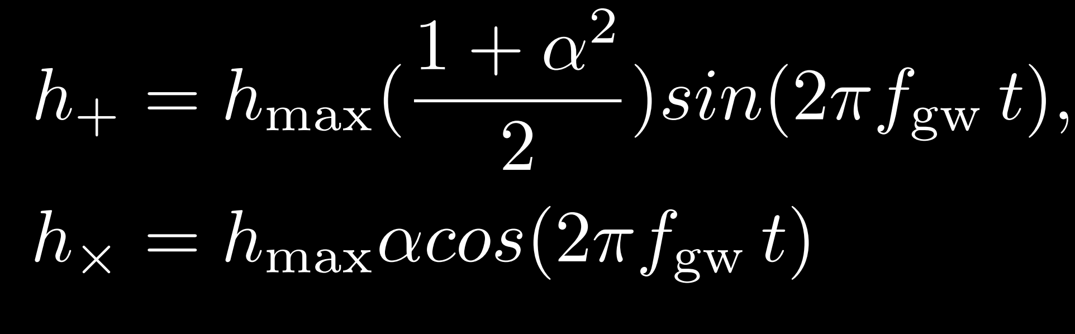
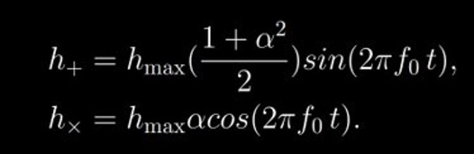
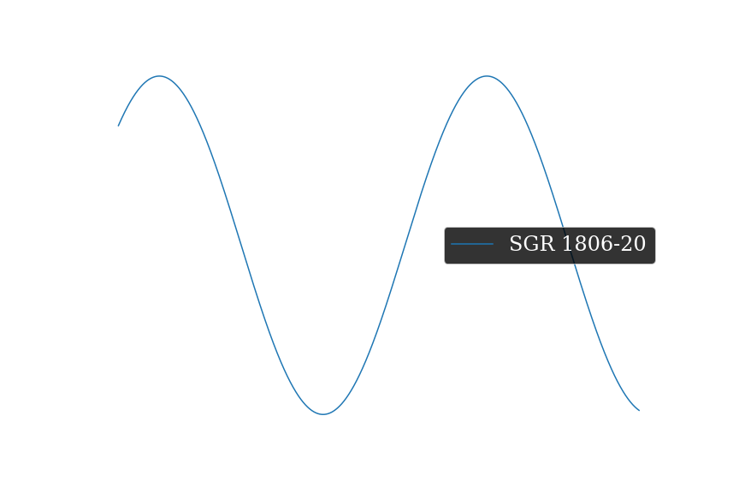
Waveforms: Starquake
Magnetar crust deforms, maybe even cracks due to the intensity of the magnetic field
Expect continuous emission after flare
f_{gw} is twice the spin frequency of the magnetar, this is ~ 0.3 Hz which is too low for the ground-based detectors
Sources: Soldateschi & Bucciantini, (2021), Sieniawska & Bejger (2019)

Slide 13
Waveforms: Starquake
α is polarization of source
Max amplitude seen at the detector
Magnetar crust deforms, maybe even cracks due to the intensity of the magnetic field
Expect continuous emission after flare
f_{gw} is twice the spin frequency of the magnetar, this is ~ 0.3 Hz which is too low for the ground-based detectors
Sources: Soldateschi & Bucciantini, (2021), Sieniawska & Bejger (2019)

Slide 14
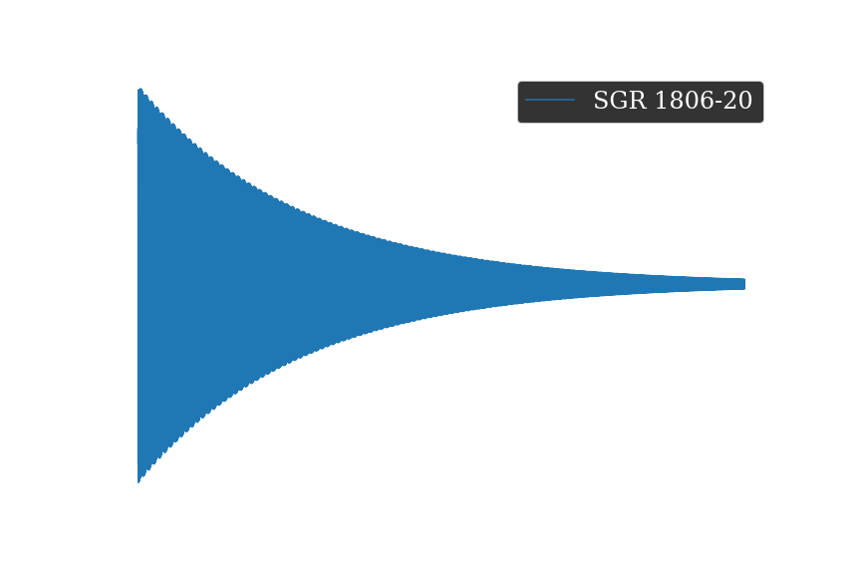
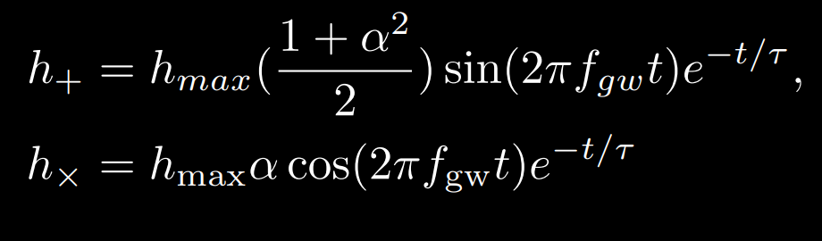
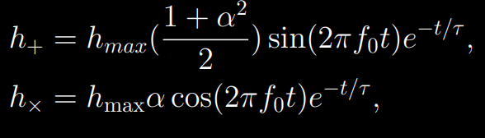

Wave Forms: Magnetohydrodynamic Waveform
Sudden global rearrangement of the magnetar’s internal magnetic field which causes the magnetars moment of inertia to suddenly increase
f_{gw} is the fundamental mode (f-mode) of the magnetar
f_{gw} ~ 2000 Hz
Sources: Soldateschi & Bucciantini, (2021), Sieniawska & Bejger (2019)

Slide 15
Wave Forms: Magnetohydrodynamic Waveform
Decay constant
Sudden global rearrangement of the magnetar’s internal magnetic field which causes the magnetars moment of inertia to suddenly increase
f_{gw} is the fundamental mode (f-mode) of the magnetar
f_{gw} ~ 2000 Hz
Sources: Soldateschi & Bucciantini, (2021), Sieniawska & Bejger (2019)

Slide 16
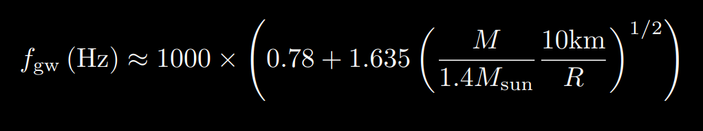
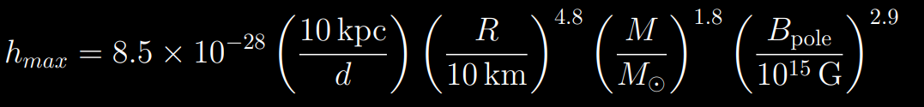
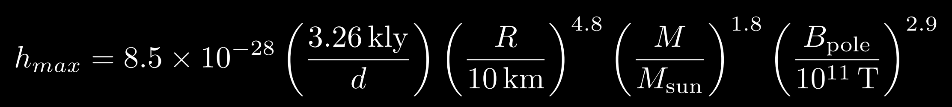
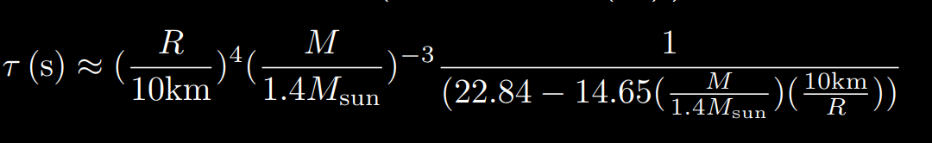
Magnetohydrodynamic Parameters
Emission frequency
For the known sources values are:
f_{gw} ~ 2000 Hz
Τ ~ 0.2s
h_{max} ~ 10⁻²⁸ – 10⁻²⁶
Based on magnetohydrodynamic simulations done by Andersson & Kokkotas, (1998); and Kouvatsos et al., (2022)
Their emission frequency is at the upper limit of the sensitivity of ground-based detectors
Max amplitude seen at the detector
Decay constant

Slide 17
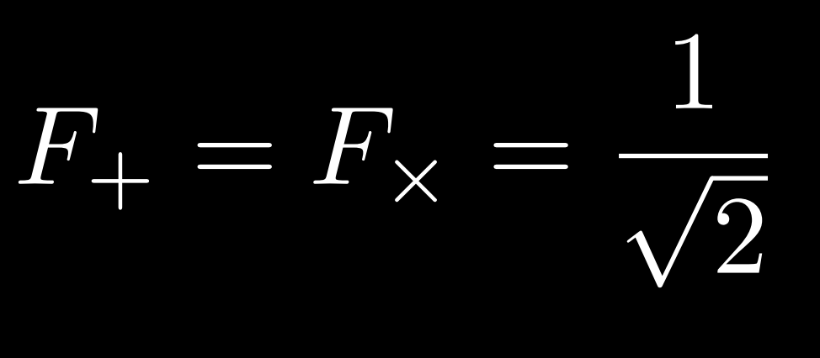
Testing Approximations
Antenna Functions:
Different for each detector
Some antenna functions not easily obtainable
Assumed sources where optimally-oriented
Results are not a sky average

Slide 18
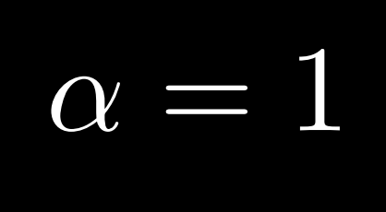
Testing Approximations
Antenna Functions:
Different for each detector
Some antenna functions not easily obtainable
Assumed sources where optimally-oriented
Results are not a sky average
Source Polarization:
Polarization depends on orientation of source relative to us
Expect real sources to have all possible values of α

Slide 19
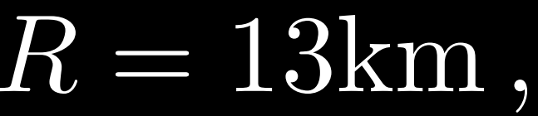
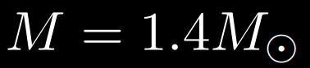
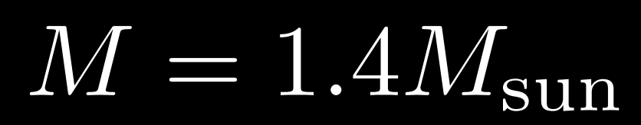
Testing Approximations
Antenna Functions:
Different for each detector
Some antenna functions not easily obtainable
Assumed sources where optimally-oriented
Results are not a sky average
Source Polarization:
Polarization depends on orientation of source relative to us
Expect real sources to have all possible values of α
Mass & Radius:
We do not know the mass & radius for all of the magnetars

Slide 20
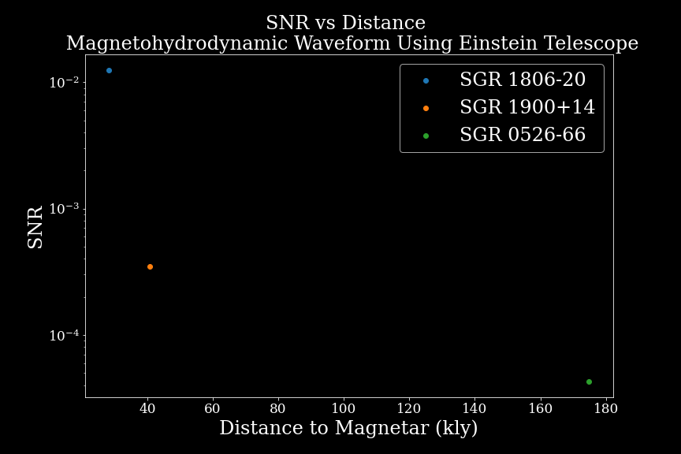
Results
Cosmic Explorer SNR:
SGR 1806-20: 2.69x10⁻²
SGR 1900+14: 5.68x10⁻⁴
SGR 0526-66: 6.93x10⁻⁵
Einstein Telescope SNR:
SGR 1806-20: 1.24x10⁻²
SGR 1900+14: 3.49x10⁻⁴
SGR 0526-66: 4.26x10⁻⁵
SGR 0525-66
SGR 1900+14
SGR 1806-20

Slide 21
Interpretation & Suggestions for Future Study
Magnetar giant flares will not be observable from ground-based third generation detectors. A giant flare would need to occur 1000x closer to Earth be observed. There are no known magnetars that close
There should be a study to determine if emission from the starquake model for magnetar giant flares will be observable for the proposed space-based detectors
Image Credit: NASA's Goddard Space Flight Center/S. Wiessinger

